Slide 1
Project Report
P.S. 17 : Business Contract Validation
Team Name: | BVM Mavericks
Team Leader: | Ronak Vekariya | 65ronakvekariya@gmail.com
Member 2: | Rohanshu Banodha | banodharohanshu@gmail.com
Member 3: | Navneetkumar Thakor | tnavneet8628@gmail.com
Faculty Mentor: | Dr. Narendra Patel Dr. Mahashweta Joshi | nmpatel@bvmengineering.ac.in mjjoshi@bvmengineering.ac.in

Slide 2
Index
Sr. No. | Content | Page no.
1 | Problem Statement | 3
2 | Idea (Solution) | 4
3 | Video | 7
4 | Features offered | 8
5 | Process Flow | 11
6 | Architecture Diagram | 12
7 | Technologies used | 13
8 | Team members and contributions | 15
9 | Conclusion | 18
10 | Note | 19

Slide 3
Problem Statement:
Business Contract Validation:
To Classify Content within the Contract Clauses and Determine Deviations from Templates and highlight them.
Description:
Business contracts are legal documents. The first task is to parse these documents so that have a structure to them. Determine the key details within the contract document. Every contract has clauses and sub-clauses. The next step is to classify the contents of the parsed documents to these clauses. Typically, a contract has an associated template to it, and it is important to determine the deviations from that template and highlight them.

Slide 4
Idea :
Our solution to the given problem statement is as follows:
The user logs into our website and uploads the contract to be parsed along with the template for comparison.
They can either upload a previous contract as a template from the same company the current contract is associated with, or use a standard template to identify deviations.
Once both the contract and template are uploaded, they are stored in cloud storage. We have used Cloudinary for storing the images of user and all their contracts as it provides secure urls which are not vulnerable to data leak. The contract is then parsed, with text and entities extracted from it.

Slide 5
The contract and template urls are then passed on to Django Backend from where they both are downloaded and kept temporarily in the storage.
The first component PDF Parser is now used. It parses the pdf to extract texts from it. Both the contract and template is passed to this component, giving us the extracted text of both.
Then extraction of entities happen. A Name Entity Recognition (NER) model is used to extract out entities present in the contract such as People involved, Organizations involved, Monetary details, Contract duration, etc. are extracted. This module helps to determine the key entities involved in the agreement.
The third component is Text Classification. Firstly, clauses are extracted from both contract and template. Using Levenshtein distance, the semantics of clauses are used to compare the clauses present in both the pdfs. After the clauses have been determined, the sub-clauses are then classified into their respective clauses.

Slide 6
Now, the data gathered after classifying the sub-clauses are then sent to a LLM which compares the data of contract and template and generate textual result of deviations which are present.
The deviations are then highlighted and the highlighted pdf is again stored at the cloud service provider and the secure link is obtained.
Finally, a summary is provided to the user, detailing the deviations and extracted entities.
Thus from Django side, entities recognized, deviations detected, summary and the url of highlighted pdf is sent to the NodeJS Backend which sends the response back to the React Frontend to the user.
The user can view the contents delivered to him and also can download the contract and the highlighted contract for future use.

Slide 7
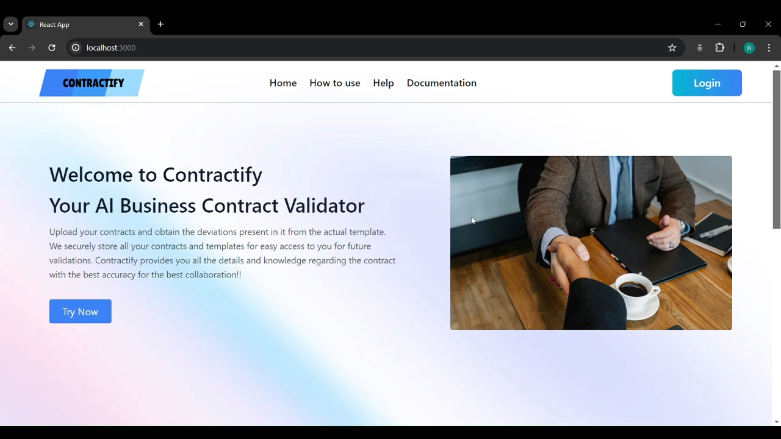
Video:

Slide 8
Features offered:
1) User Authentication and Authorization:
Implemented secure user authentication and authorization using JSON Web Token (JWT) to ensure data privacy.
2) User History:
Added a mechanism to store the history of user so that he can obtain the deviations by keeping the older version of the contract as the template.
3) User Master Template:
User can update the master template as per his requirements and then compare it with the contract in which the deviations need to be figure out.

Slide 9
4) Saving contracts at Cloud:
Integrated use of Cloudinary to securely store the contracts of user and their highlighted pdfs and provide access to the contracts stored at cloud.
5) Key Entities extraction:
Used HuggingFace Flair Named Entity Recognition (NER) model for extracting key entities from the contract such as People involved, Organizations involved, Addresses, Amount, Duration, etc. having capability of extracting 18 different class of entities.
6) Text Classification:
Identifying and extracting clauses and sub-clauses from contracts, and classifying sub-clauses correctly within their clauses.

Slide 10
7) Obtain Deviations:
Comparing the contract against the template uploaded by user (Master Template or Older versions of the same contract series) and obtaining the deviations present in them in terms of Amount, Duration, Organization, Terms and Conditions, etc.
8) Highlighting Deviations:
Highlighting the deviations obtained in the pdf and uploading the highlighted version on the cloud for easy and secure retrieval of the contract.
9) Summary Generation:
Obtain a brief summary regarding the whole process and concluding the validation process by summarizing the entities involved and the deviations present.

Slide 11
Process Flow:
Client uploads the contract and the template of his choice.
Both the pdfs are then stored in a secure cloud provider "Cloudinary" for easy retrieval and storage efficiency.
Contract and Template are then parsed.
Obtaining Deviations between the contract and the template.
Classifying sub-clauses within their clauses correctly for both contract and template.
Extraction of Entities from the Contract.
Highlighting the deviations in the contract and uploading it to Cloudinary.
Summarizing the outputs from every components.

Slide 12
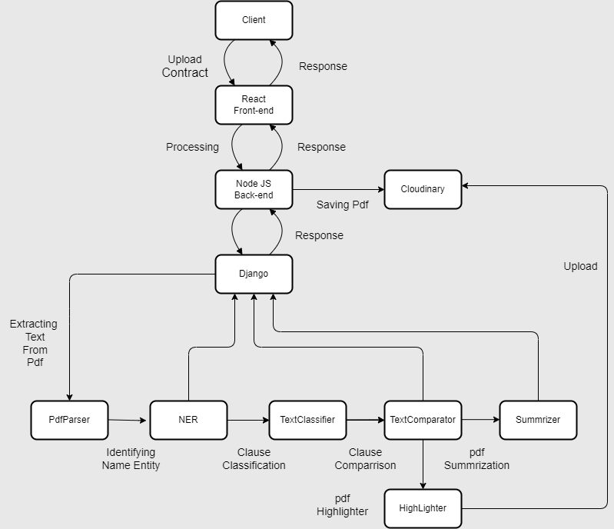
Architecture
Diagram:

Slide 13
Technologies used:
The following technologies are used:
React – React is used for the frontend part enhancing UI/UX.
NodeJS – NodeJS backend for handling frontend requests and to send requests for
MongoDB – For storing user details and their search histories.
Express – For developing API endpoints an handling HTTP requests.
Django – For handling requests coming from Node backend for contract validation.

Slide 14
Python – Programming language used for making the components.
LLMs – Gemini for generating textual content for comparison and classification.
Flair – NLP Model for extracting entities from the pdf.
Cloudinary – For storing user contracts securely.
JWT – Json Web Token for User Authentication and data retrieval.
Streamlit - For demonstration of individual component workings and overall program.
Docker - Docker for building Images of Django Backend, NodeJS Backend, React Frontend and main Control FLow.
Tailwind – Tailwind CSS for enhancing User Interface and styling of the website.

Slide 15
Team members and contributions:
1) Ronak Vekariya
Collected and Processed Data to create a Dataset for Name Entity Recognition(NER) task.
An attempt to fine tune the pre-trained model for recognizing business contract entities more effectively.
Extracted the most probable Clauses from the Template pdf.
Classified contract sub-clauses under the above clauses by Levenshtein distance similarity measure.
Compared deviations between the clauses and sub clauses of contract and template.
Created Django endpoint for contract and template fetching from Cloudinary, optimizing disk storage.
Handled issue of Bad Request of the HuggingFace deployed model, which gave error when the model is not in the memory of HuggingFace as it consists of Serverless deployment.
Created Streamlit files for the components I created and created corresponding README files for providing essential instructions.

Slide 16
2) Rohanshu Banodha
Created NodeJS backend endpoint for User Authentication and for request to be sent to Django server ensuring CORS policy.
Helped in the designing of React User Interface of the Home page.
Created components such as pdf-parser for retrieval of test and implemented HuggingFace NER model giving the name entity pairs along with their accuracy of prediction.
Developed pdf highlighter module, highlighting the deviations present in the template for users to quickly look up to the deviations present.
Added functionality of Streamlit for individual components so that each and every single component can be tested separately and also for the whole contract validation task.
Performed Dockerization by creating 4 separate images of Control Flow, Django backend, NodeJS backend and React frontend.
Gathered Data for Training the NER Model as an attempt to fine tune the model.
Debugging of errors occured while performing unit tests, integration tests and System tests.
Created of README.md for providing essential instructions regarding the components.

Slide 17
3) Navneetkumar Thakor
Created React Frontend for the Project by giving functionalities to select his choice of template to find deviations with.
Used TailwindCSS for elegant UI.
Created MongoDB Collections such as User, Templates and User History.
Created NodeJS API endpoints for functionalities such as user authentication and login, storing the results of contract validation and saving their files in their respective MongoDB Documents.
Created Summary module for providing brief summary of whole validation process.
Attempt to train NER Model by helping making dataset.
Created main flow file consisting of all the components classes and integrating them together.
Created Django endpoints for receiving contract and template urls and performing the validation task.
Created README.md for NodeJS Backend and React Frontend for providing essential instructions regarding installation of packages and starting the servers.

Slide 18
Conclusion:
The training program has been a great experience which helped us gain industry level experience and skills. The mentors were supportive and helped us resolve our doubts easily. This training program helped us gain knowledge in new technologies and broaden our knowledge in Natural Language Processing and Docker.
The project title "Business Contract Validation" was a challenging and engaging project and we are thankful to Intel Unnati for providing us this opportunity in gaining industry-level practices.

Slide 19
Note:
All the codes (final merge) for this project is available in the following Github repository:
https://github.com/navneetthakor/Business-contract-validation
To validate the contributions of individuals in the team, one can validate it by viewing the contributions in the folllowing github repositories as the work was first done separately to avoid conflicts.
Link1 https://github.com/navneetthakor/bcv-django-backend
Link2 https://github.com/navneetthakor/bcv-node-backend
Link3 https://github.com/navneetthakor/bcv-frontend-new

Slide 20
Thank You...

